Slide 1
Student Attendance Management System
Automating attendance tracking using OOP
Target Users: Schools / Colleges / Teachers

Slide 2
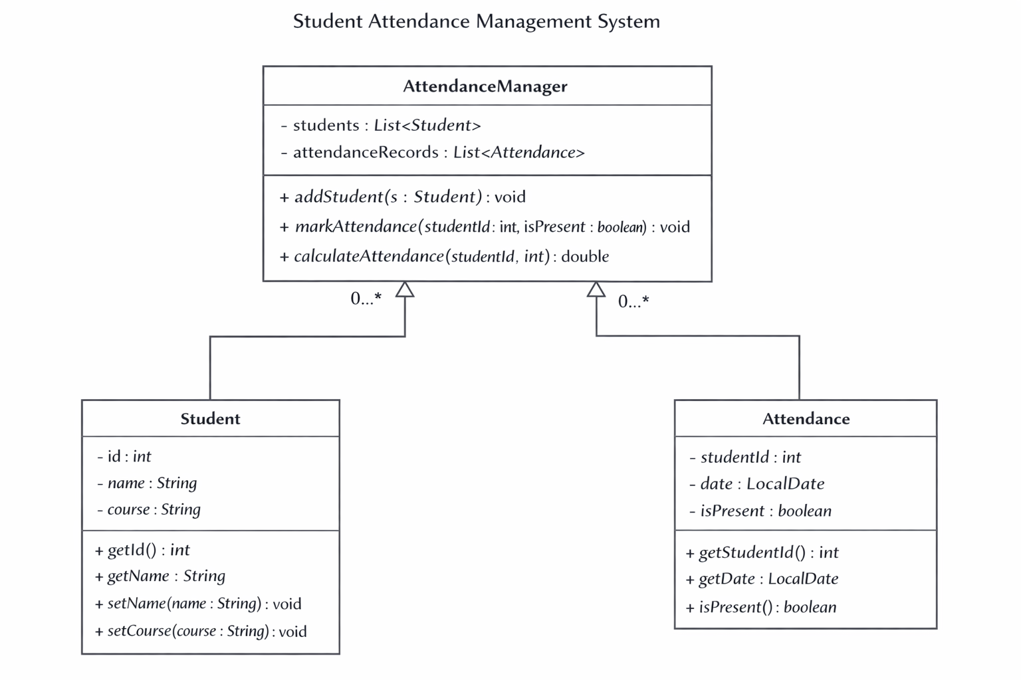
System Design
Model: Student, Attendance
Service: AttendanceManager
Exception: Custom Exceptions
Main: CLI Interface

Slide 3
OOP Concepts Used
Encapsulation: Private fields in Student
Abstraction: AttendanceManager hides logic
Polymorphism: Custom exceptions
Layered architecture design

Slide 4
Technical Highlights
Attendance calculation with edge-case handling
File-based persistence (CSV)
Real-time tracking using LocalDate

Slide 5
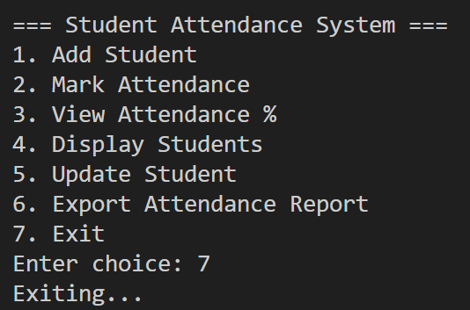
Live Demo Plan
Add Student
Mark Attendance
View Attendance %
Show error handling (invalid ID)

Slide 6
Conclusion & Future Scope
Automates attendance efficiently
Reduces manual errors
Future: GUI, Database, Performance optimization

